Slide 1
Loops
Lo! Oops :)!

Slide 2
Quick Checklist
1. Previous class recap
2. Loops
while and do-while loops
for loops
foreach loops
nested loop
3. Excercises
4. Assignment

Slide 3
What is a "Loop"?
A loop is a basic programming construct that allows repeated execution of a fragment of source code.
Depending on the type of the loop, the code in it is repeated a fixed number of times or repeats until a given condition is true (exists).
Loops that never end are called infinite loops

Slide 4
While loops

Slide 5
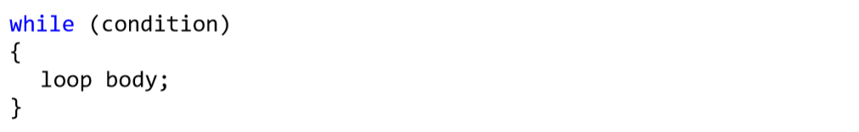
While Loops
One of the simplest and most commonly used loops is while.
In the code above example, condition is any expression that returns a Boolean result – true or false. It determines how long the loop body will be repeated and is called the loop condition. In this example the loop body is the programming code executed at each iteration of the loop, i.e. whenever the input condition is true

Slide 6
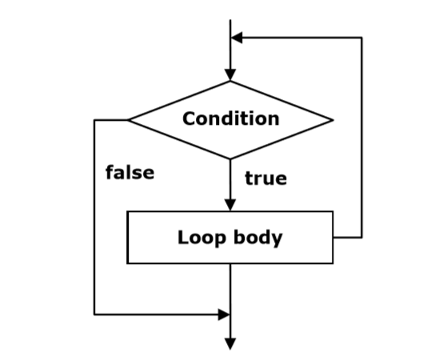
Schema for while loop behaviour

Slide 7
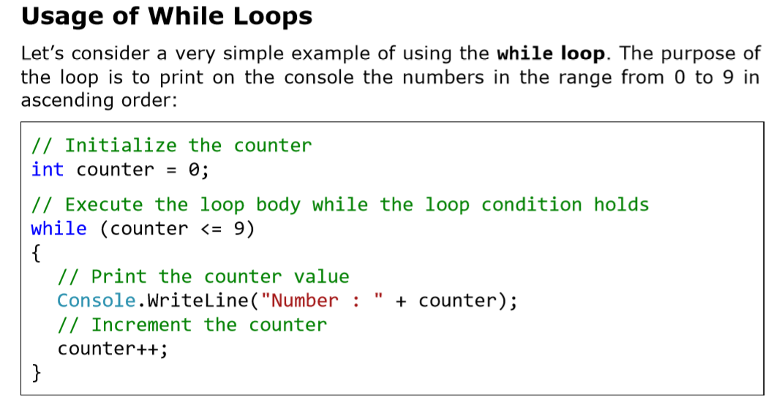

Slide 8
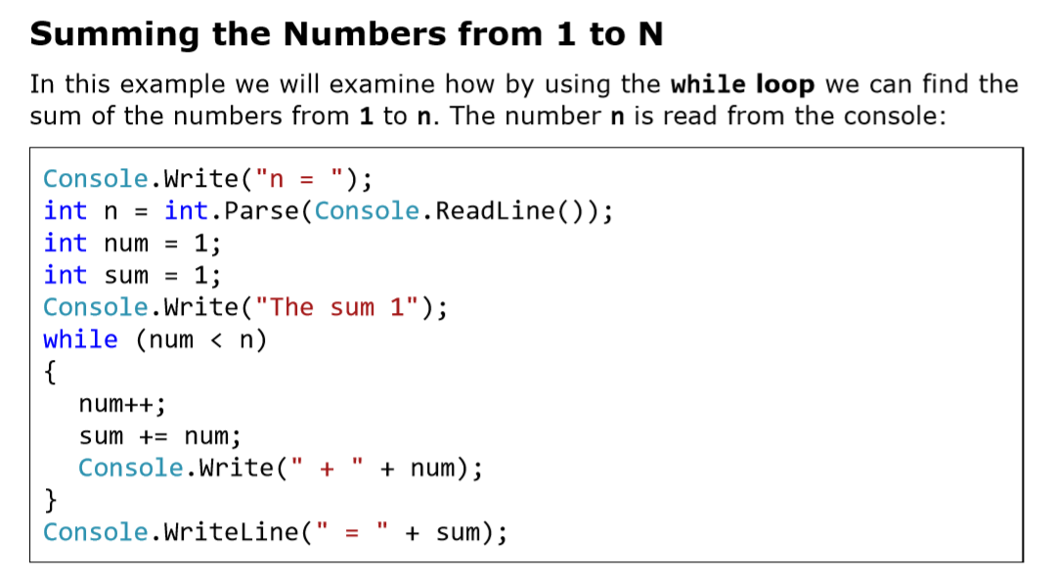

Slide 9
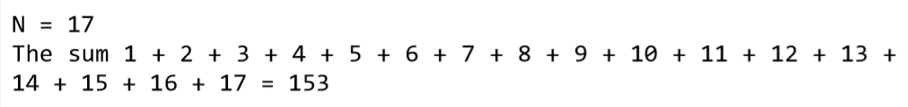
The result of the program’s execution is as follows
(we enter n = 17)

Slide 10
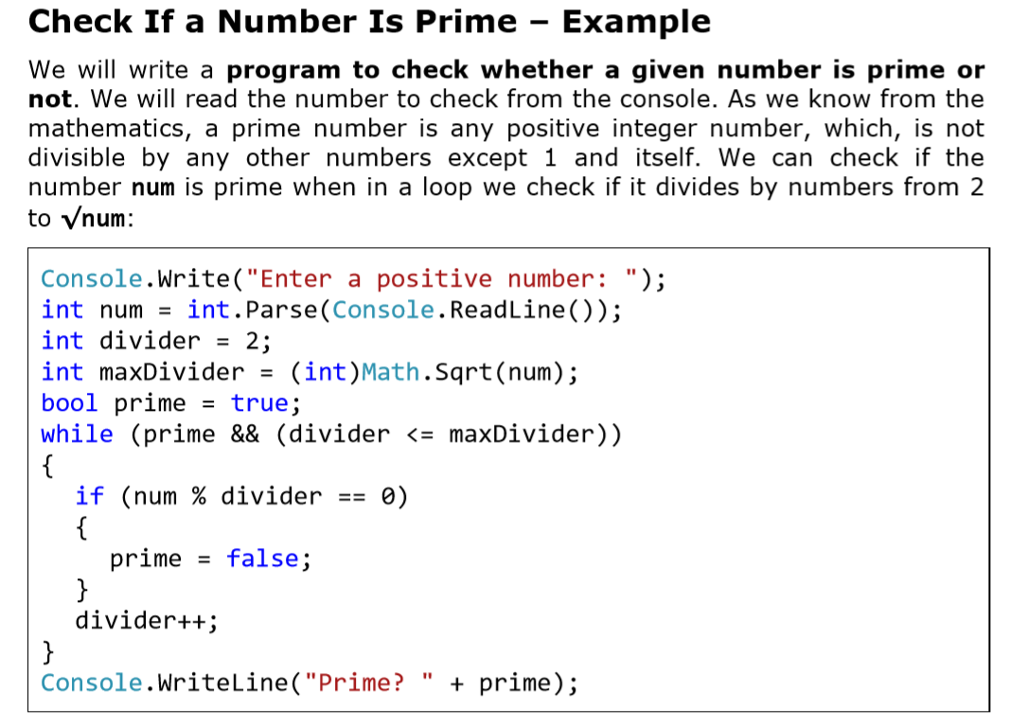

Slide 11
Do-While loops

Slide 12
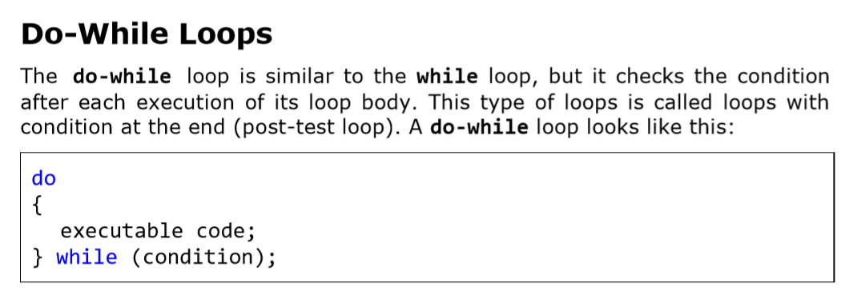

Slide 13
Initially the loop body is executed. Then its condition is checked. If it is true, the loop’s body is repeated, otherwise the loop ends.
This logic is repeated until the condition of the loop is broken. The body of the loop is executed at least once. If the loop’s condition is constantly true, the loop never ends.

Slide 14
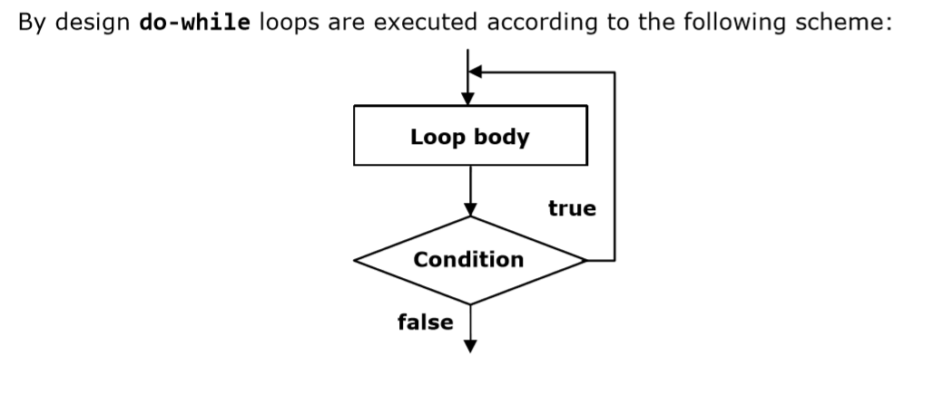

Slide 15
Elements of a loop
The elements required for any loop include:
The name of a control variable
The initial value of the control variable
The loop-continuation condition
Tests for the final value of the control variable (whether looping should continue)
The increment or decrement by which the control variable is modified each time through the loop

Slide 16
For loop

Slide 17
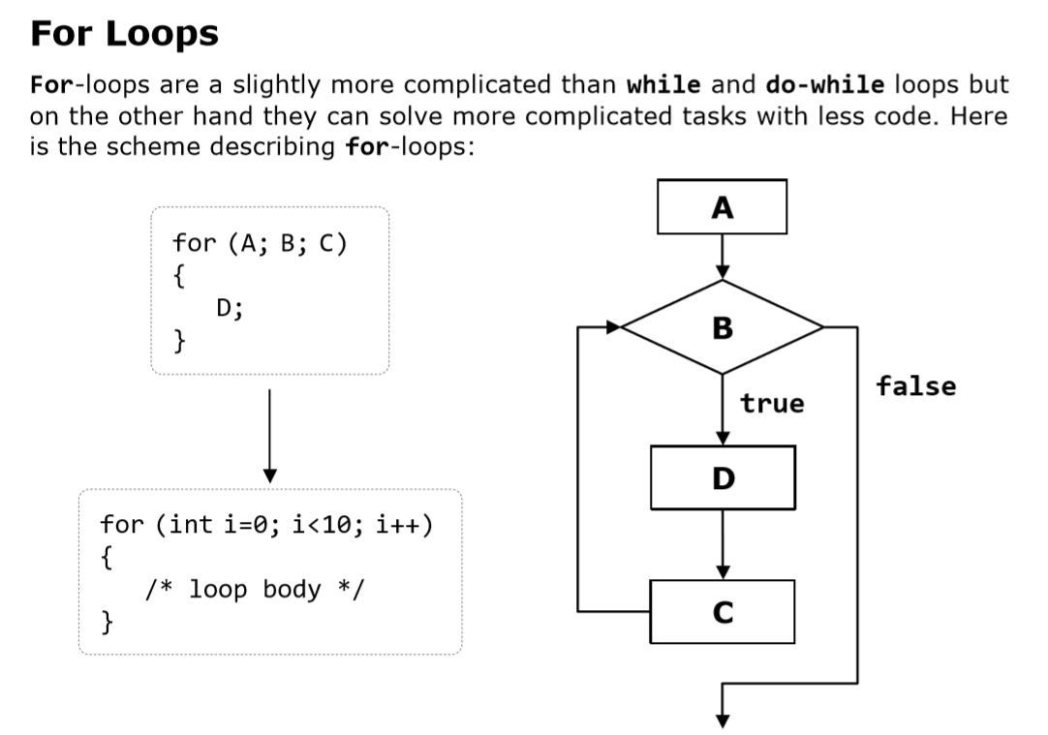

Slide 18
Syntax
for (initialization; condition; update)
{
statements; //Loop’s body
}
Note the positioning of the semi-colons

Slide 19
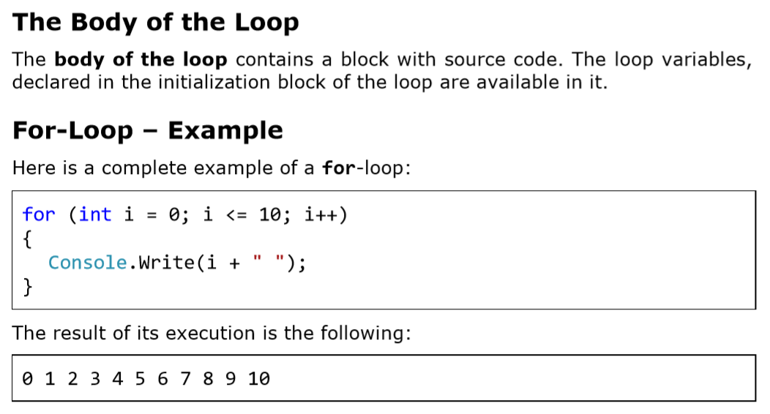

Slide 20
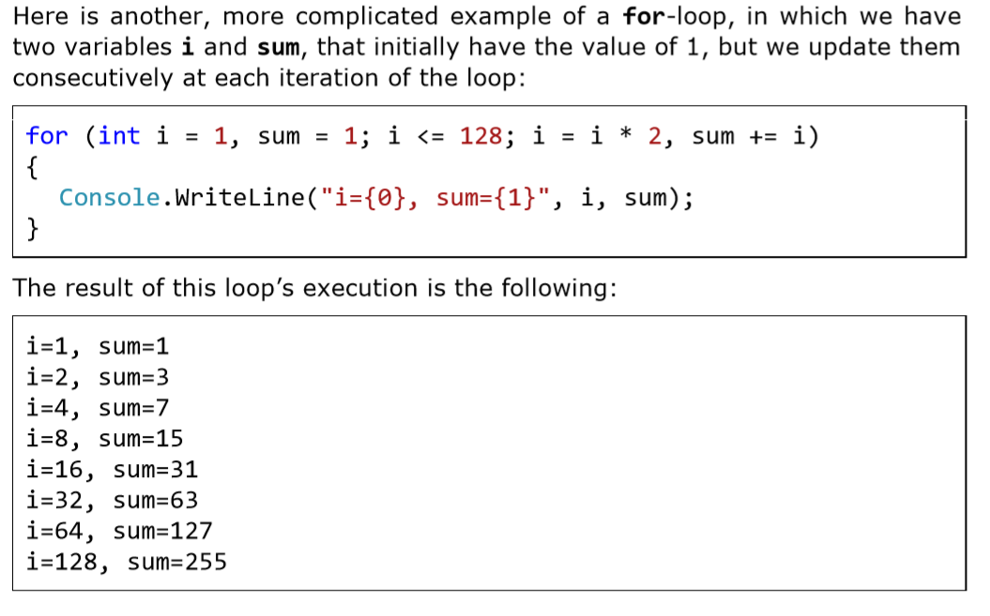

Slide 21
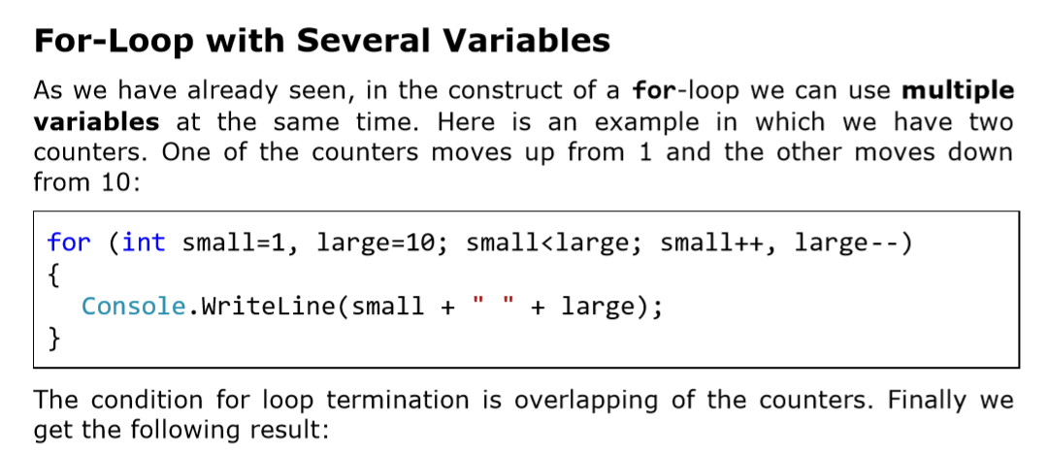

Slide 22
1 10
2 9
3 8
4 7
5 6

Slide 23
Foreach loops

Slide 24
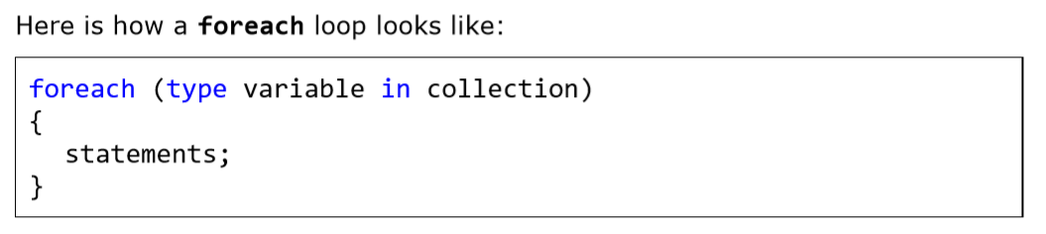
Foreach Loops
This programming construct serves to iterate over all elements of an array, list or other collection of elements

Slide 25
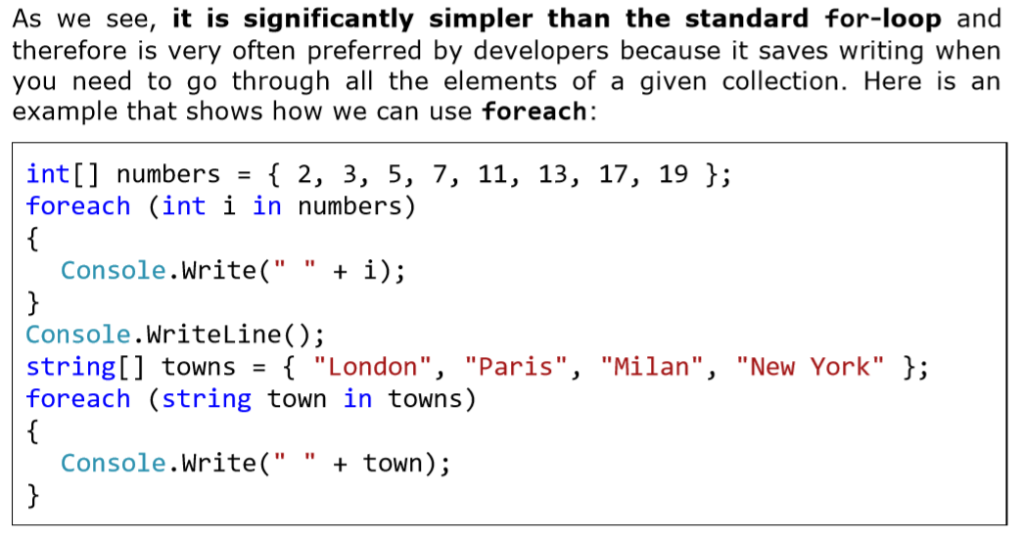

Slide 26
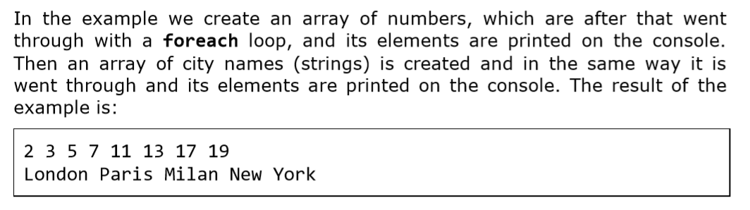

Slide 27
Nested Loops

Slide 28
Nested Loops
The nested loops are programming constructs consisting of several loops located into each other.
The innermost loop is executed more times, and the outermost – less times. Let’s see how two nested loops look like:

Slide 29
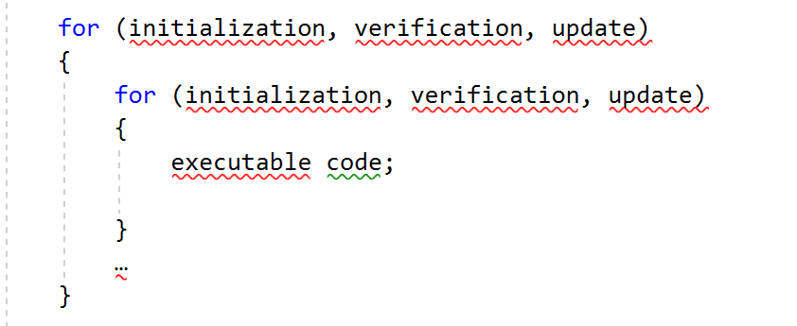

Slide 30
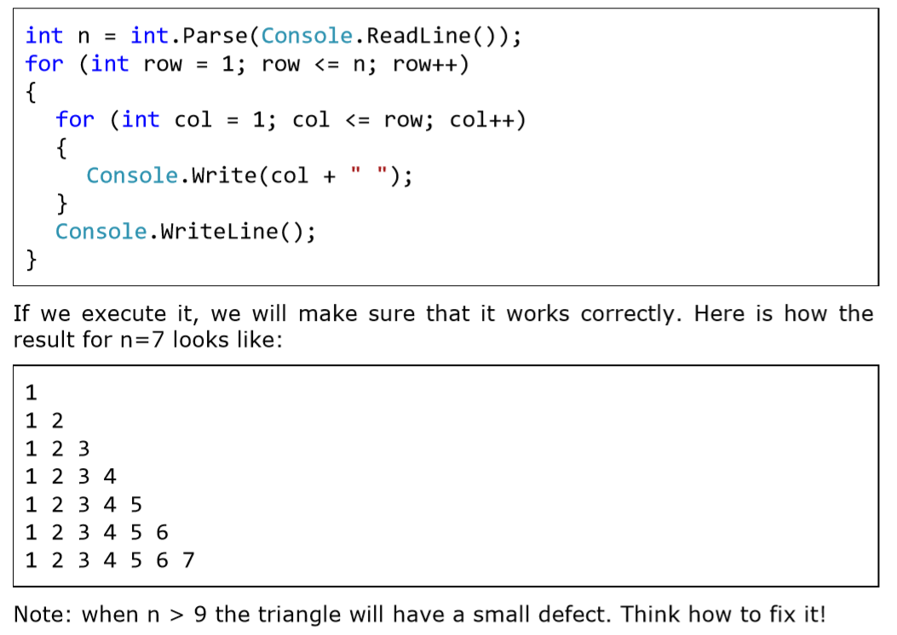

Slide 31
exercise

Slide 32
1. Write a program that outputs the numbers 12-28.

Slide 33
2. Write a program to compute the sum of numbers between 20 and 25

Slide 34
3. Using the do…while loop, write a program that outputs the even numbers between 12-50.

Slide 35
4.Using a do…while loop write a program to compute the sum of numbers between 30 and 45

Slide 36
5. Using the for loop, write a program that outputs the numbers: 12, 14, 16,18,20,22,24,26,28

Slide 37
6. Write a program that prints on the console the numbers from 1 to N. The number N should be read from the standard input. (Hint use a for- loop)

Slide 38
Assignment

Slide 39
1. Using a while loop write a program that calculates the sum of integers input by a user. The program should allow the user to enter as many numbers as possible, until the user enters 0.

Slide 40
2. Write a program that reads from the console a series of integers and prints the smallest and largest of them. (Hint you’ll need a for-loop)

Slide 41
3. Write a program that by a given integer N prints the numbers from 1 to N in random order.

Slide 42
4. Write a program that prints on the console the numbers from 1 to N, which are not divisible by 3 and 7 simultaneously. The number N should be read from the standard input. (Hint use a for- loop)

Slide 43
End :)!
Ooko Emmanuel

